Slide 1
Cancer Biology Biol 445
Spring 2013
Dr. Heidi Super
Lecture 27
4-12-2013

Slide 2
Announcements
Priority for D-ball planning?
Confusion about involving businesses?
--I’m willing to give 15-20 minutes of lecture time (today and next week) to take care of D-ball business!

Slide 3
Where were we? …
Carcinogens
Mutagens
Tumor promoters
Tobacco
Alcohol
Lung cancer in smokers
Never smoker lung cancer

Slide 4
Food-containing carcinogens
Synthetics-----Pesticides, preservatives, chemical additives. When possible, eat what mother nature made. Look for 5 or fewer ingredients on a food label! Wash fruits and veggies!
Naturally-occurring chemicals
Pest resistance chemicals produced by plants
Table 4-3

Slide 5
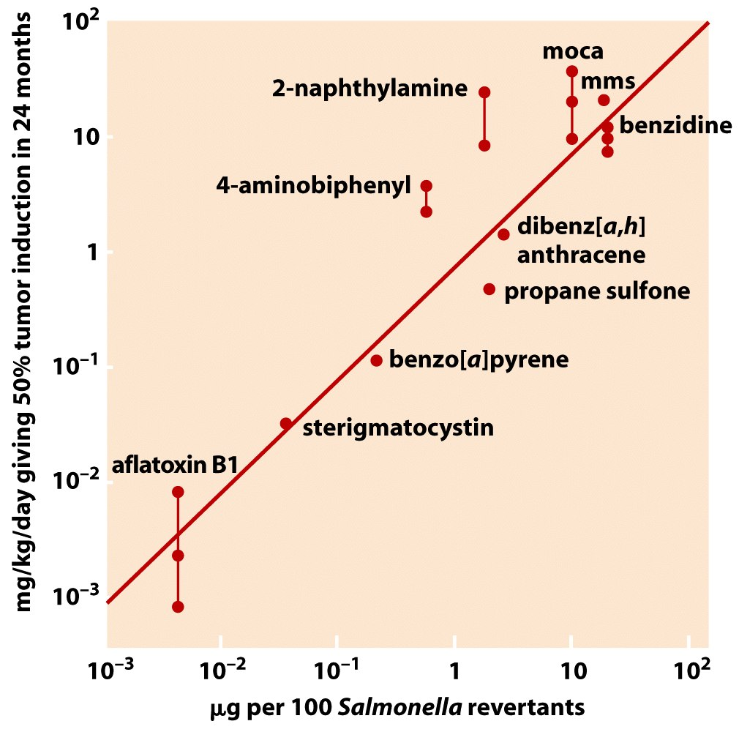
Figure 2.25 The Biology of Cancer (© Garland Science 2007)

Slide 6
Aflatoxin is produced by Aspergillus, a mold which is common on grain and nuts.
Highly mutagenic/carcinogenic
It’s inhibition by synthetic by synthetic pesticides in developed countries likely outweighs the risk of ingesting the pesticide!

Slide 7
Preservatives
Salt, nitrites, nitrates used to preserve meat and fish.
Hotdogs, bacon, etc.
Linked to stomach cancer---
Salt—prolonged exposure leads to inflammation (and high blood pressure and heart diseased)
Nitrates/nitrites---metabolic intermediates made in stomach are highly carcinogenic

Slide 8
Red meat, fat
High red meat consumption correlates with high colon cancer rates.
Figure 4-11

Slide 9
Why?...
Difficult to pinpoint the mechanism.
More red meat=less fruit/veggies (with potential anticancer chemicals)
More red meat =more saturated fat
More red meat =more calories=more obesity
More red meat = more carcinogens produced by cooking methods (grilling, or high prolonged heat)

Slide 10
Likely that all the correlated exposures related to consuming red meat indirectly lead to increased DNA damage to colon cells.
Clearly the components of consumed red meat make their way through the colon!

Slide 11
Anticancer? food chemicals…
Lycopene---tomatoes ☺
Epigallocatechin gallate---green tea antioxidant☺
Resveratrol—red grapes (wine! ☺)
Sulfides-wine, garlic ☺
See website linked to USDA/ NCI information!
**Take Shipunov’s pharmaceutical ethnobotany class!

Slide 12
Antioxidants
Compounds that inhibit oxidation reactions.
Oxidation reactions create free radicals that can damage/change DNA.
Avoiding mutations, reduces cancer risk.

Slide 13
USDA rankings for antioxidant activity
Small red bean (dried)
Wild Blueberry
Red kidney bean
Pinto pean
Cultivated blueberry
Cranberry
Artichoke
Blackberry
Prune
raspberry

Slide 14
Be smart!
Don’t accept merely anecdotal support for a carcinogen or anti-carcinogen claim.
Look for published experimental evidence.
In published evidence, look for proper controls, be aware of bias—make sure the publication does not come from a company that makes money from the product.
Make sure the publication was reviewed by experts (peer review process).

Slide 15
Radiation and cancer
2 primary classes:
UV
Ionizing

Slide 16
Evidence?
UV—sunlight exposure linked to skin cancer
Much higher incidence in people of light skin (melanin absorbs UV radiation and keeps it from inducing DNA damage)
Much higher incidence in locations of intense, prolonged sun or individuals who intentionally expose themselves to UV (outside, tanning beds)

Slide 17
Evidence?
Ionizing radiation
High cancer rates among workers using X-rays.
Cancers among workers using radioactive isotopes (Marie Curie)
MANY other dose-effect “experiments”
Japanese survivors of the WWII atomic bombings.
Survivors of atomic energy plant mishaps.

Slide 18
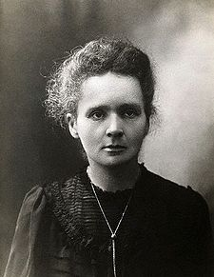
http://en.wikipedia.org/wiki/Marie_Curie
Dr. Collins’ life work is possible because of Marie Curie!!

Slide 19
Finally…
Pathogens and cancer!
Review! We have gone over many!
Summary Figure 4-13.

Slide 20
Chemical carcinogens—chapter 5
Most identified through industry development and cancer in people with occupational exposure.
Table 5-1

Slide 21
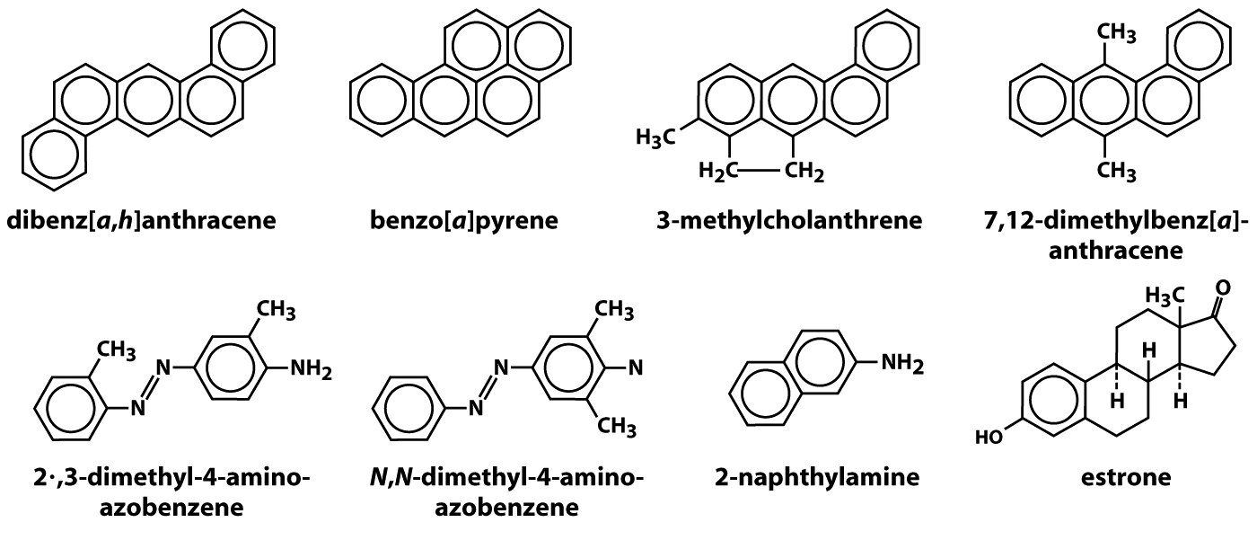
Figure 2.22 The Biology of Cancer (© Garland Science 2007)

Slide 22
Recall the importance of the dose-effect relationship
3 models used to test/describe potential carcinogens.
Linear model
Threshold model
Hormetic model
Figure 5-6

Slide 23
Each chemical required experimental testing to prove carcinogenicity
Animal studies
Previously discussed pros and cons
Mammals overall good indicators of cancer-causing potential for humans.
Potential for dosing or susceptibility/biochemistry problems
The story of saccharin!
Figure 5-5

Slide 24
Some medicinal chemicals now known carcinogens.
Table 5-2
DES—synthetic estrogen
Used in 1940s to prevent miscarriages.
Causes vaginal cancers in next generation!
Immunosuppressive drugs
Chemotherapy drugs

Slide 25
Suspected link of cancer and chemicals spurred the establishment of government agencies to protect humans against exposure
Occupational Safety and Health Administration (OSHA)

Slide 26
Agencies like OSHA report on experiments in animals and rate chemical carcinogens in two basic categories.
1. Known human carcinogen—animal + human data.
2. Reasonably anticipated human carcinogen--animal data used to extrapolate to human risk
See appendix B in your text.

Slide 27
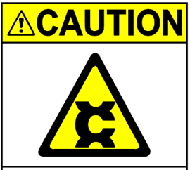

Slide 28
Organic carcinogen classes
Polycyclic hydrocarbons----products of incomplete combustion (Coal, meat, oil, tobacco)
Aromatic amines—(benzene + NH₂) Many used in production of industrial dyes.
N-nitroso compounds (N-N=O) (research reagents, tobacco smoke, nitrate/nitrite intermediate)
Alkylating agents—various chemical formulas, all able to add alkyl groups to other molecules.
5. Other---natural bioproducts.—Aflatoxin, or plant derived chemicals

Slide 29
Inorganic carcinogens
Asbestos
Nickel compounds
Chromium compounds
Cadmium* compounds
Minot State University researchers (Beachy, Keller, Super, Bobylev) have National Institutes of Health grants to study cadmium and health.

Slide 30
What happens to these compounds in cells?
Recall---Ames test included exposure of potential mutagens/carcinogens to enzymes that would act on the compound in cells.
Often metabolic derivatives which are the mutagens/carcinogens.

Slide 31
Liver cells have many enzymes that work on pre-carcinogens, providing the relevant metabolic products.
**Role of liver, in part, is to detoxify ingested chemicals so they can be secreted without causing harm.
Sometimes harmless chemicals become more harmful in the process.

Slide 32
Most of these liver enzymes are members of a family of proteins called Cytochrome P450 family.
These enzymes are hemo-proteins (complexed with iron) and capable of oxidation-reduction reactions.

Slide 33
Cytochrome P450 enzymes oxidize chemicals to make them more water soluble—more excretable.
Figure 5-8

Slide 34
Role of cytochrome P450 enzymes—stringently tested.
Dose-effect! Animals which produce abnormally high levels of these enzymes are more susceptible to cancer induced by polycyclic hydrocarbons.
Inhibitors of CYP450 enzymes protect animals from some chemically-induced cancers
Smoking elevates the levels of cyt. P450 in liver!

Slide 35
Mutagenic activity of carcinogens
One nearly unifying characteristic of organic and inorganic carcinogens.
Ability to form covalent bonds with DNA.
Called DNA adduct—may be transient or long-term.

Slide 36
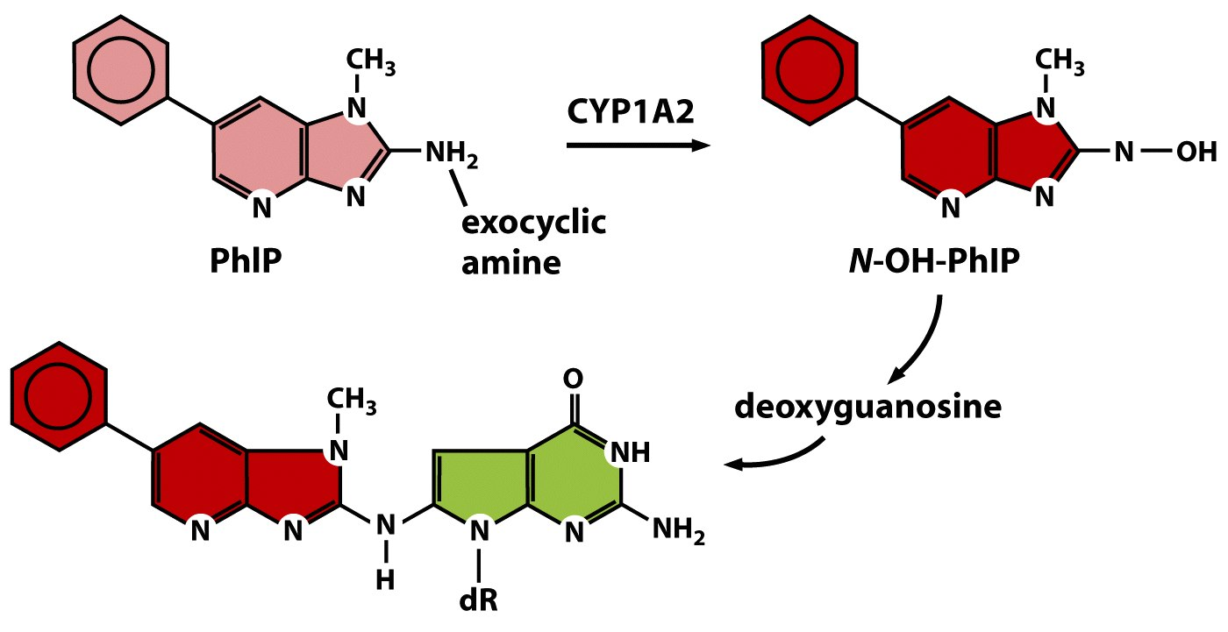
Metabolic intermediate
Pre-mutagenic compound
DNA adduct
Guanosine base (DNA)
Figure 12.19b The Biology of Cancer (© Garland Science 2007)

Slide 37
Figure 5-9
Study of several polycyclic hydrocarbons confirmed that mutagenicity (determined in Ames test) correlates strongly with DNA binding.

Slide 38
mechanism
Metabolism in the liver, creates intermediates which lack electrons. They become electrophillic.
Cellular macromolecules like proteins, RNA, and DNA are composed of electron-rich atoms and are therefore likely targets of electrophilic compounds.

Slide 39
E.g.
Nucleic acid bases are N-rich. Specific bonding makes some N atoms especially electron rich.
Especially good targets for electrophillic attack.

Slide 40
CYP450 creates chemical intermediates that have reactive groups called epoxide groups.
Epoxide groups react with various bases of the DNA
Figure 5-3
Figure 5-11

Slide 41
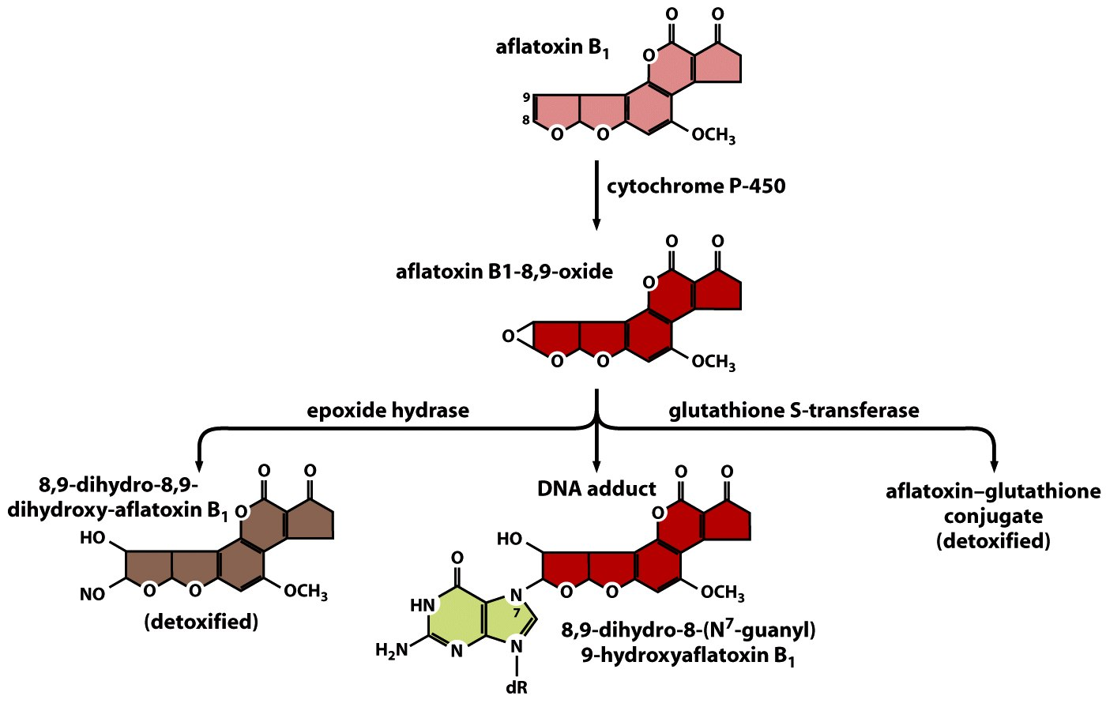

Slide 42
Some metabolic derivatives are so reactive they do most of their damage in the liver.
E.g. Aflatoxin exposure is tightly associated with liver cancer.
Some intermediates survive long enough to be secreted from liver and enter circulation. They end up in cells of other tissues.

